Slide 1

Commonality Analysis
OMSE 551 Strategic Software Engineering
Diana Dukart
November 29, 2007

Slide 2
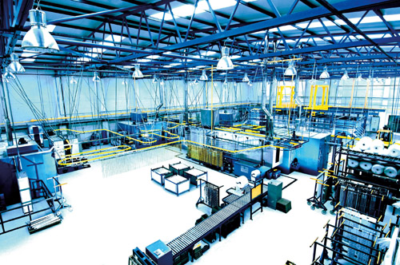
Agenda
Overview
Interfaces
Commonalities
Variabilities
Decision Model

Slide 3
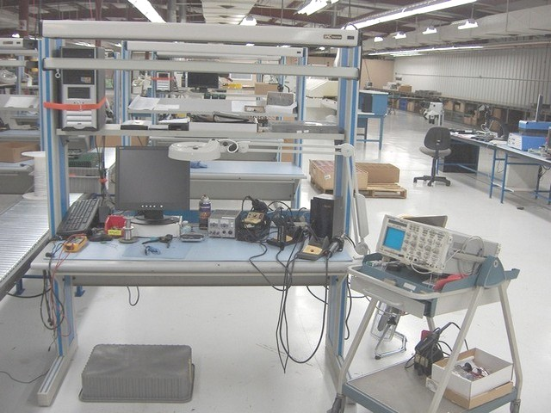
Overview
Bench
Equipment
Unit Under Test
Process
Certificate of Calibration

Slide 4
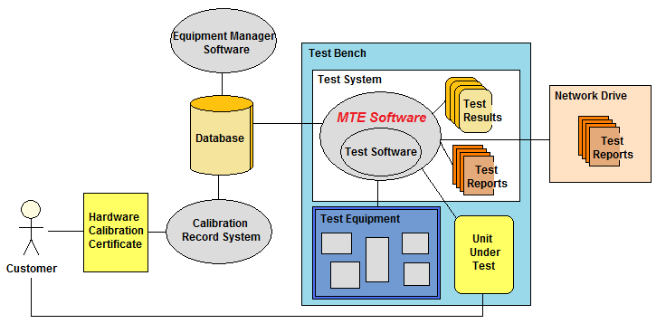
Interfaces

Slide 5
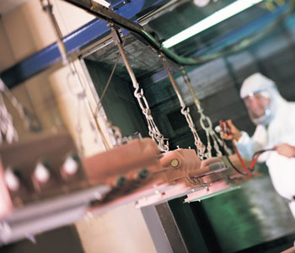
Commonalities
Equipment Validation
Information Gathering
Test Execution
Error and Failure Handling
Data Logging

Slide 6
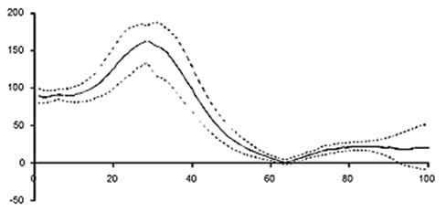
Variabilities
Unit Under Test
Tests
Equipment
Online/Offline
Database
Simulation Mode

Slide 7
Decision Model
Decision | Order (Phase)
Type of hardware to test | 1
Tests to execute | 1
Equipment used in testing | 1
Simulation testing ability | 1
Online or offline test mode | 2
Hardware drivers needed | 2
Serial number generation | 2
Database to use | 3
Report generation ability | 3
Network report storing ability | 3

Slide 8


